Slide 1
~100x faster
faster
“The good old days”
Hadoop
comparable or inconclusive
2008
Vertica (Pavlo)
HIVE (Thusoo)
2009
Pregel (Malewicz)
HaLoop (Bu)
Spark (Zakaria)
Dremel (Melnik)
2010
SystemML (Ghoting)
Hyracks (Borkar)
2011
GraphLab (Low)
2012
Impala (Cloudera)
Giraph (Tian)
Cumulon (Huang)
Shark (Xin)
2013
epiC (Jiang)
SimSQL (Cai)
2014
“The age of uncertainty”

Slide 2
What can we conclude?
Hadoop was probably just pretty bad
The rest of the story not so clear

Slide 3
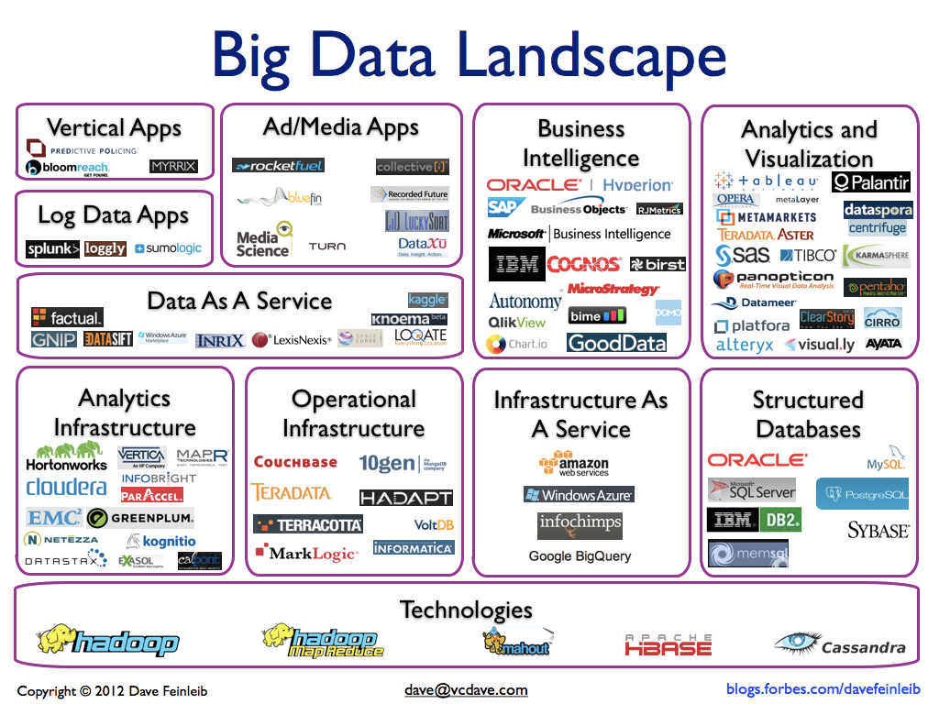
Notes:
There has been a “Cambrian explosion” of Big Data systems – no way to tell which one to use for your problem, and anyway they are all impossible to use without being a distributed systemsIT expert
Nearly useless for science in their current state

Slide 4

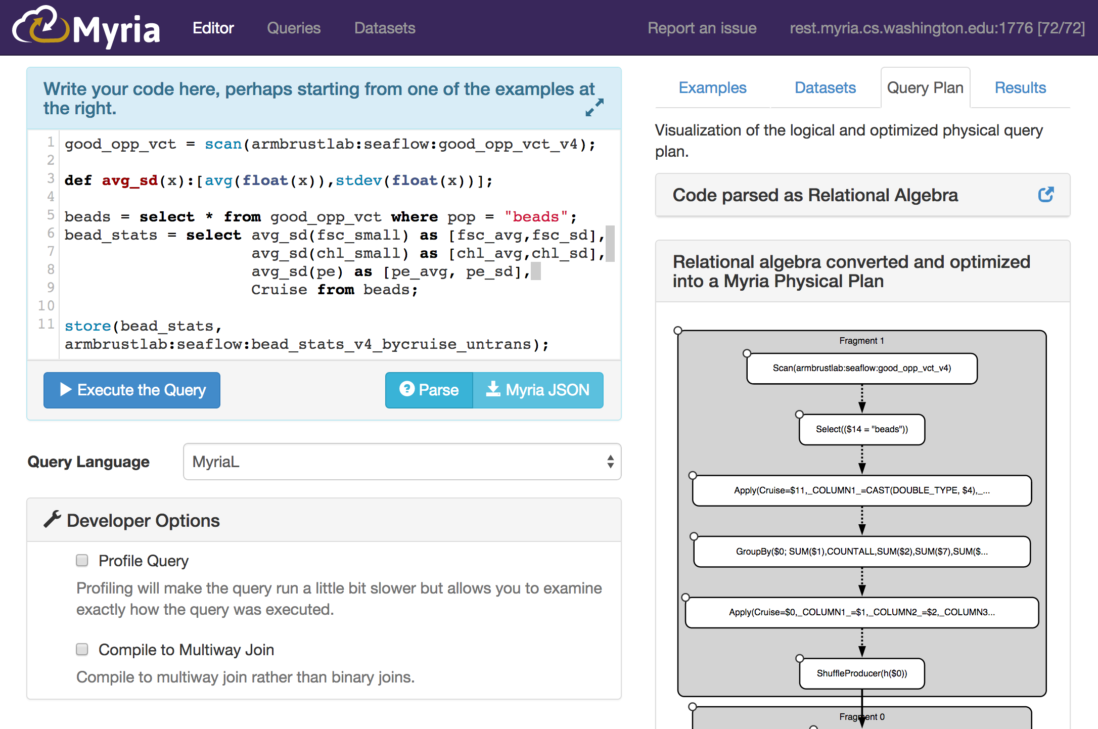
Three components:
Federated Big Data Middleware; Cross-Platform Analytics-as-a-Service
MyriaWeb: Analytics-as-a-service: Editor, profiler, data catalog, logging, all from your browser
MyriaMiddleware: Optimizing middleware for big data systems – write once, run anywhere: Hadoop, Spark, MyriaX, straight C, RDBMS, PGAS, MPI, …
MyriaExec: An iterative big data execution engine. Complex analytics at scale, with the DNA of a database system
http://myria.cs.washington.edu
Notes:
We need services -- talk directly to analysts

Slide 5
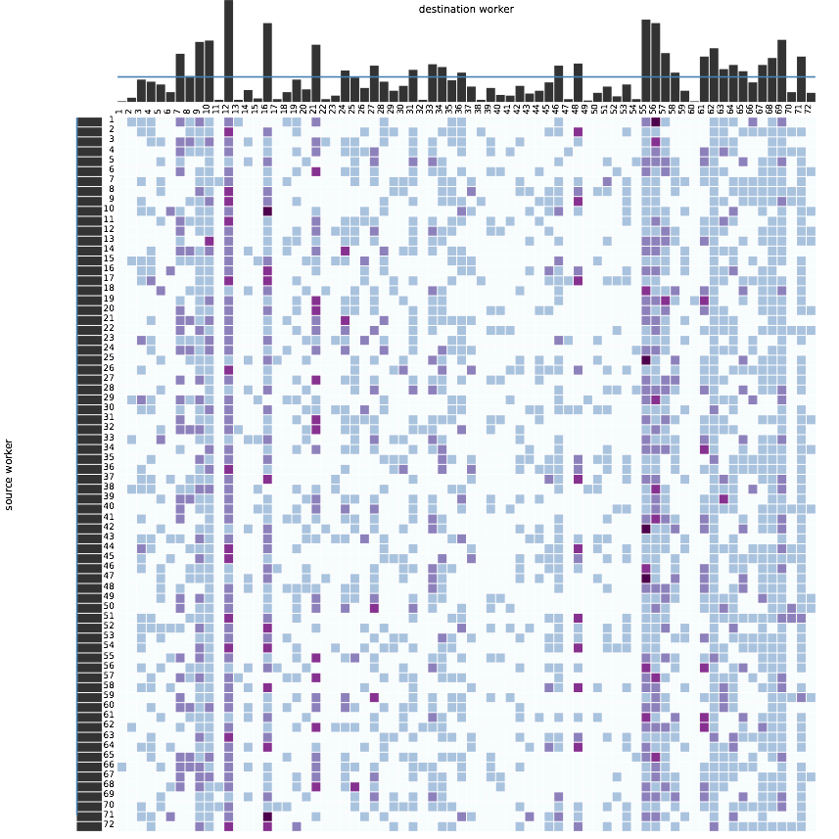
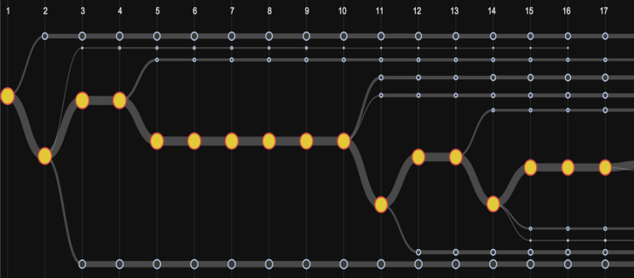

multiple GUIs/apps
multiple languages
MyriaL
Datalog
SQL
multiple big data systems
Compiler
Compiler
Compiler
Compiler
Compiler
Compiler
MyriaX
PGAS/HPC
Serial C++
RDBMS
Hadoop
(via layers)
SPARQL
(GEMS)
Notes:
You’ll see these applications in the demo

Slide 6
Myria Architecture
Datalog
SQL
MyriaL
Web UI
REST
Language Parser
Logical Optimizer for RA+While
MyriaQ (Python)
Myria Compiler
C Compiler
Grappa
SciDB
MyriaX (Java)
json query plan
REST Server
Coordinator
Catalog
netty protocols
Worker
Catalog
Worker
Catalog
…
Worker
Catalog
jdbc
jdbc
jdbc
RDBMS
RDBMS
RDBMS
HDFS
HDFS
HDFS
Notes:
Multiple input laguages, multiple output languages, all RA based
Database on every node for local processing
Everything in memory, but can push down into database
Push-based processing with back pressure to keep queues filled (a bit of streaming influence)
Column-oriented tuple-batches between workers.
Row-oriented on disk, typically, but depends on the database
Support

Slide 7
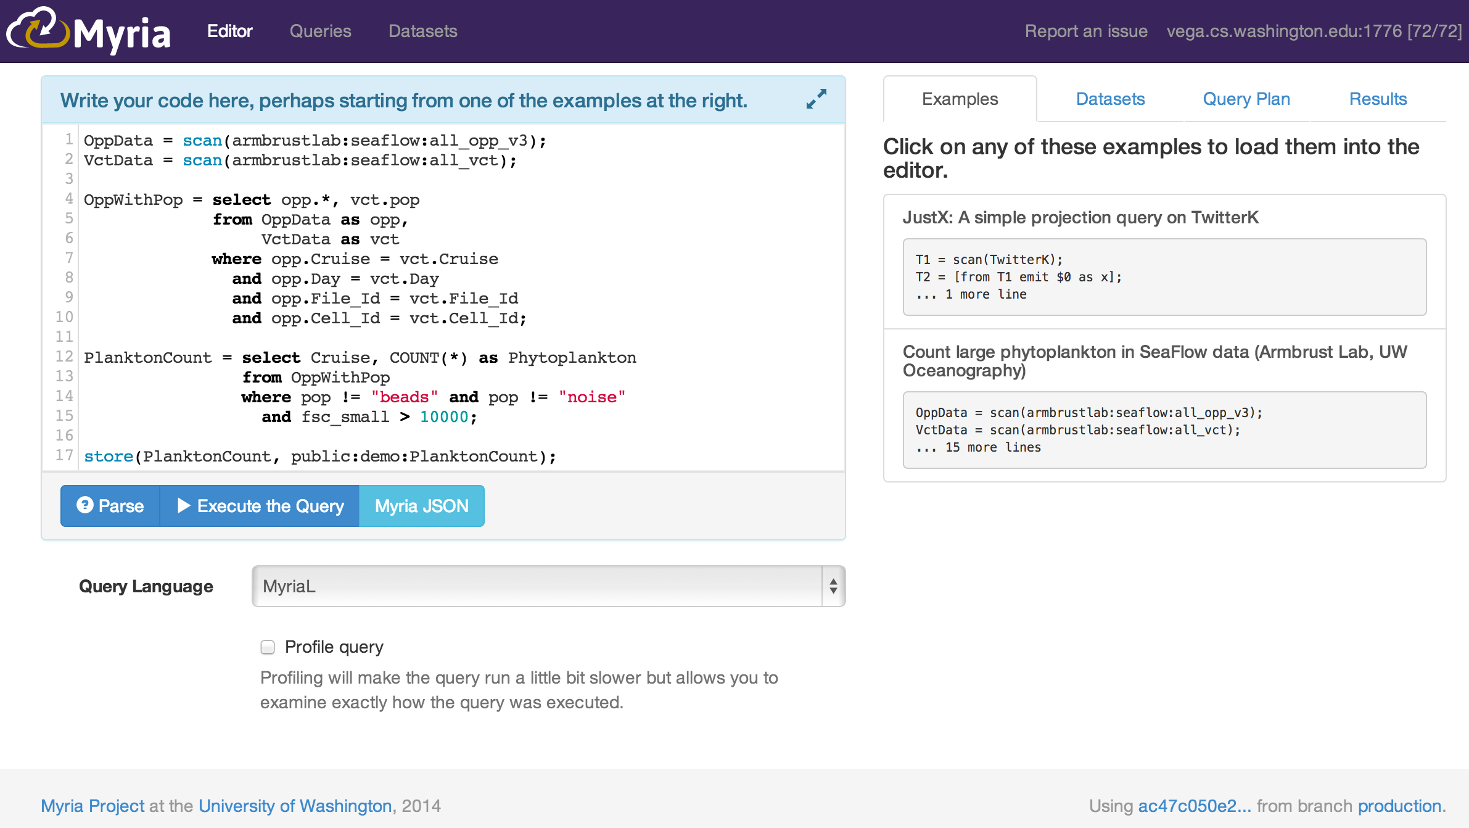
Lowering barrier to entry

Slide 8

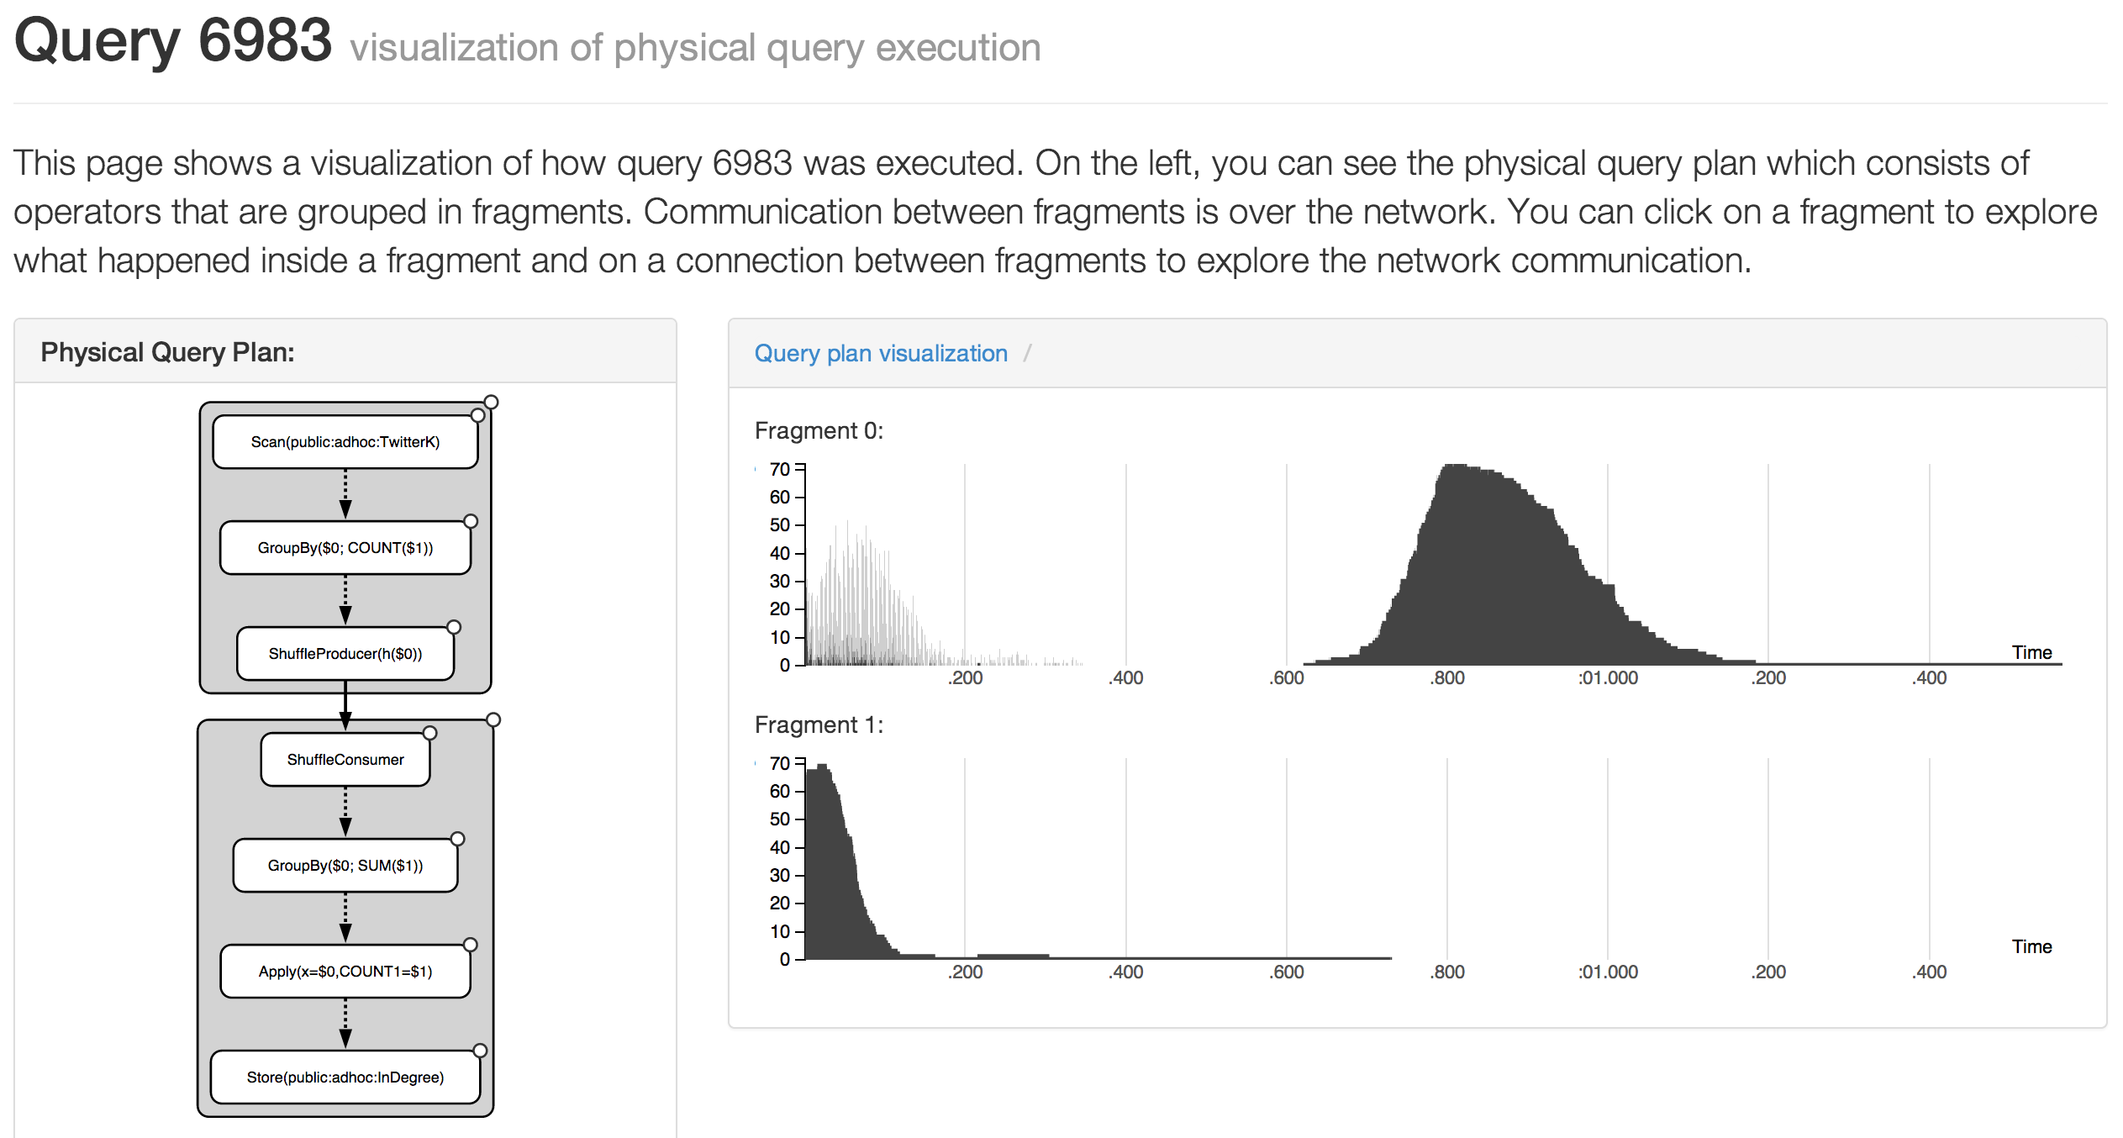
Giving users insight
Dominik Moritz

Slide 9
Diagnosing problems
Dominik Moritz
Destination node
Source node

Slide 10

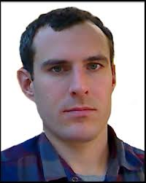

EX: SeaFlow
Francois Ribalet
Ginger Armbrust
Jarred Swalwell
Nozzle
d1
FSC
(Forward scatter)
Microscope Objective
Pine Hole
Lens
Red fluo
Laser
d2
Orange fluo
Notes:
Advantage/ inconvenient sheath fluid alignment particles/laser. Sheath fluid replacement. Loading samples to the instrument.
Advantage/ inconvenient sheathless

Slide 11
Ex: SeaFlow
Francois Ribalet
Ginger Armbrust
Jarred Swalwell
Nanoplankton
Ultraplankton
d1 / FSC
RED fluorescence
Picoplankton
IS
Prochlorococcus
d2 / FSC
FSC
Continuous observations of various phytoplankton groups from 1-20 μm in size
Based on RED fluo: Prochlorococcus, Pico-, Ultra- and Nanoplankton
Based on ORANGE fluo: Synechococcus, Cryptophytes
Based on FSC: Coccolithophores

Slide 12
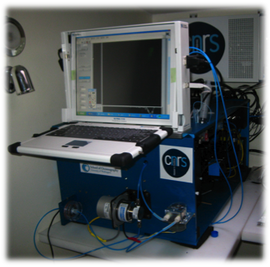
Ex: SeaFlow
Francois Ribalet
Ginger Armbrust
Jarred Swalwell

Slide 13


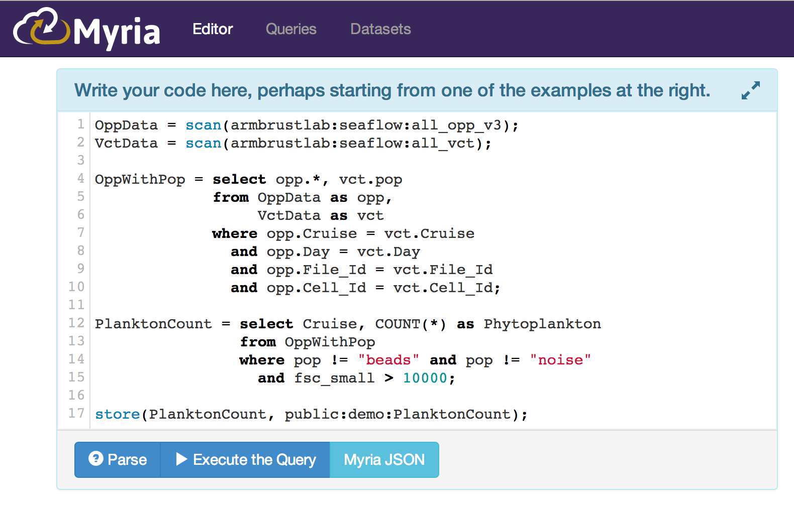
SeaFlow in Myria
Dan Halperin
Sophie Clayton
“That 5-line MyriaL program was 100x faster than my R cluster, and much simpler”

Slide 14
Federation

Slide 15
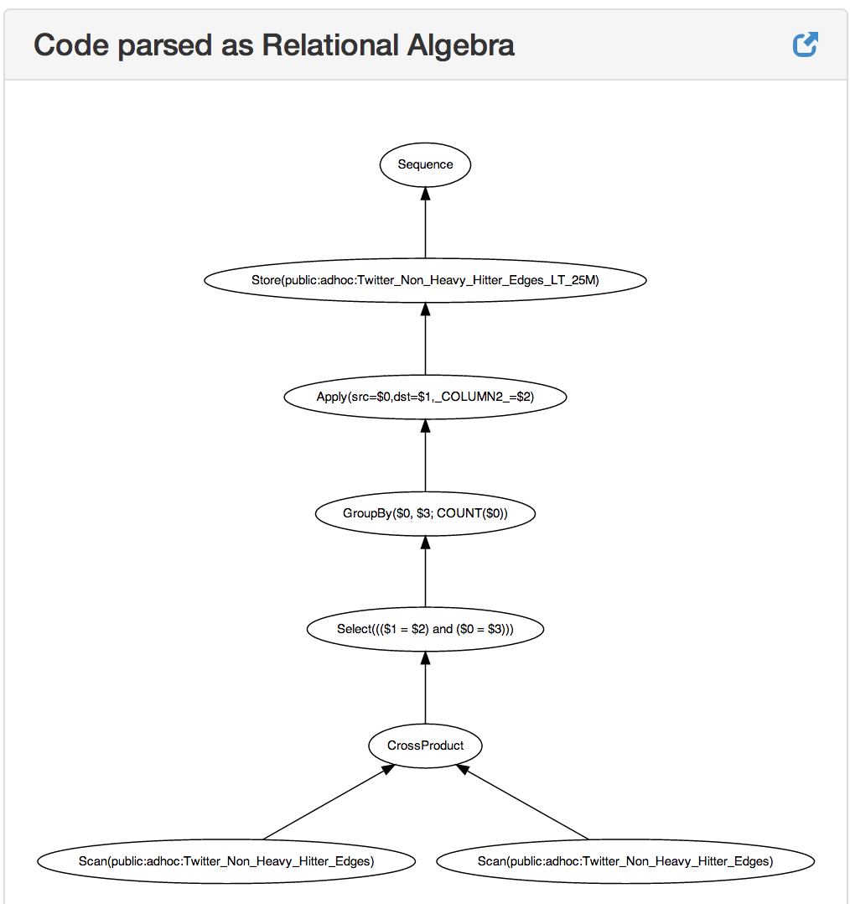
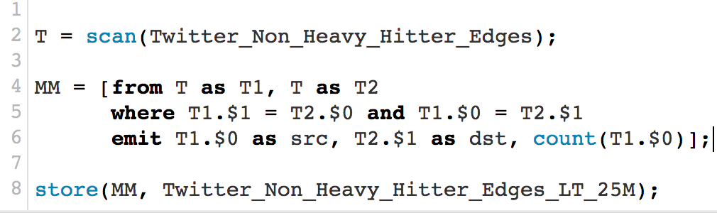
What does MyriaMiddleware do?
(2) Program is parsed as an expression tree….
(1) Client submits a program in one of several Big Data languages….
(or programs directly against the API…)
Notes:
MyriaL is an imperative language we like; I’ll show you some examples of that.
The whole program is chained together as one big expression, perhaps with loops

Slide 16
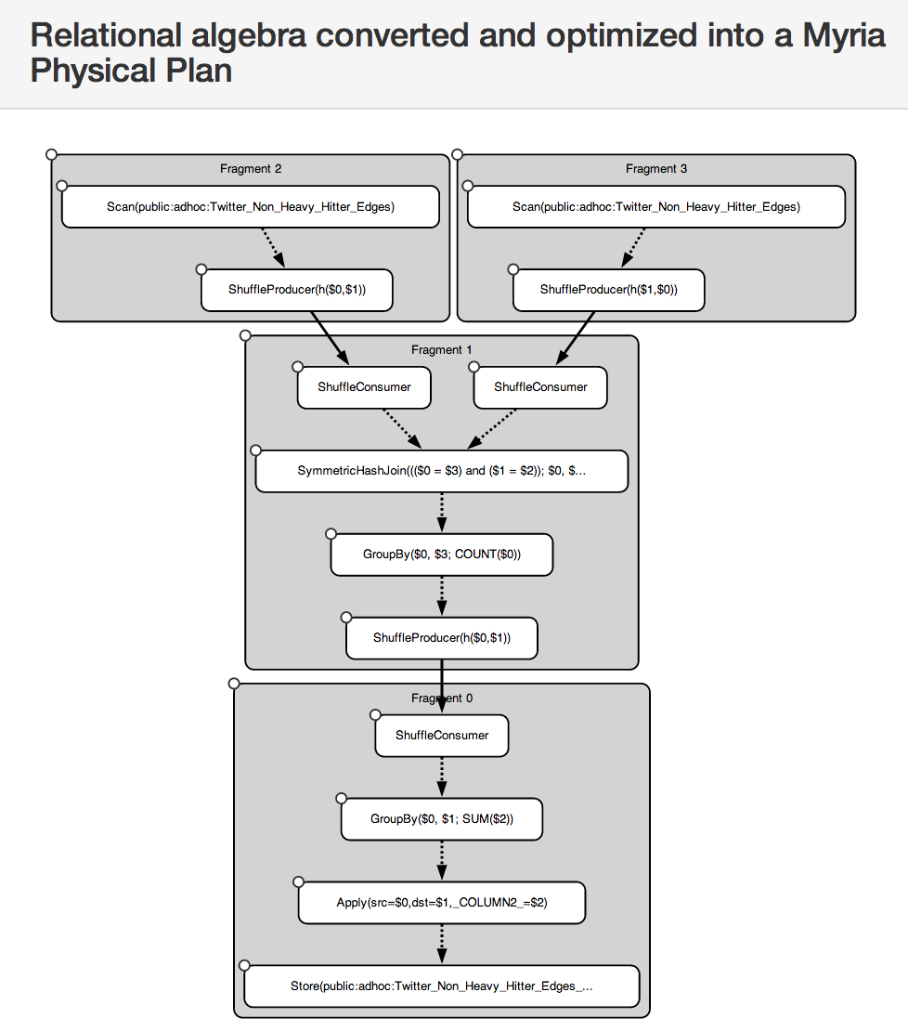
What does MyriaMiddleware do?
(3) Expression tree is optimized into a parallel, federated execution plan involving one or more Big Data platforms.
(4) Depending on the back end, parallel plan may be directly compiled into executable code
Notes:
The logical plan is translated into a possibly federated, typically parallel back-end specific physical plan.
Optimization rules are applied as appropriate.
We’ve gotten more mileage than we expected out of just a simple rule-based optimizer, for two reasons: we have tried to make it very easy to add new rules on the fly, and we have made some algorithmic developments.
For example, there’s been a lot of recent work on worst-case optimal join algorithms that scale with the size of the output rather than (only) the size of the input.
One of our students has developed a variant of these worst-case optimal, multi-way join algorithm that looks like it could subsume the need for a lot of fretting about join order, skew handling, broadcasting, merge vs. hash, etc.

Slide 17
What does MyriaMiddleware do?
Myria Middleware
Client
Sys1
(5) Orchestrates the parallel, federated plan execution across the platforms
Sys2
Notes:
Single interface to multiple big data systems
* No one size fits all – there WILL be multiple systems and multiple tasks in play in realistic scenarios
* Developer attention span is the bottleneck: Your data scientists can’t/won’t do the plumbing to make these systems talk to each other
* Every system either a) claims to do everything or b) claims nobody else can do “their” thing. We need to stop the madness and do some good science.
We need a middleware

Slide 18
What does MyriaMiddleware do?
(6) Exposes query execution logs and results through a REST API and a visual web-based interface

Slide 19
What do backend systems need to provide?
An AST for your language/API/algebra
A mapping from Myria Algebra into your AST
Anecdotally, this has been easy
Array data models will be harder, but appears tractable
Graph data models have been a natural fit
(optional) Any custom optimization rules you require
Here’s where the rubber meets the road
If a system requires a million special cases to achieve acceptable performance, then a rule-based approach may not be effective
(optional) An implementation of an “Administrative API”
execute, schema browsing, monitoring/logging/vis, fetch, kill, restart, statistics, user management
facilitates downstream applications for workspace management, auditing, visualization, sharing

Slide 20
Integrating query processing with parallel programming languages
Notes:
expect to graduate in just over a year and now finished my thesis proposal exam
icde: 30 min for talk + feedback (4pm KST)
relevant reviews:
I think the student may benefit from discussing at the workshop the exact placement of this proposal in the existing area of *distributed data management models and tools*.
I would like to see this thesis discussed at the PhD symposium to set an example of a good systems thesis proposal

Slide 21
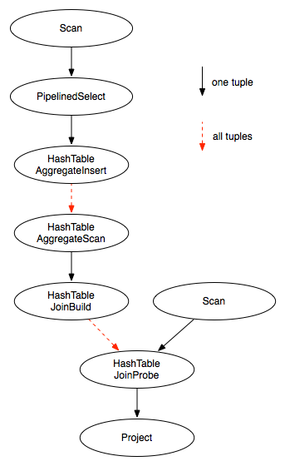


Query compilation for distributed processing
[Crotty ’14, Li ’14, Seo ’14, Murray ‘11]
[Myers ’14]
pipeline fragment
code
pipeline as parallel code
pipeline fragment
code
sequential compiler
sequential compiler
parallel compiler
machine code
machine code
Notes:
NOTES:
Optimizations enable?
with better semantics on a hash table join with UDFs, can do redundant computation elimination, code motion from UDF

Slide 22

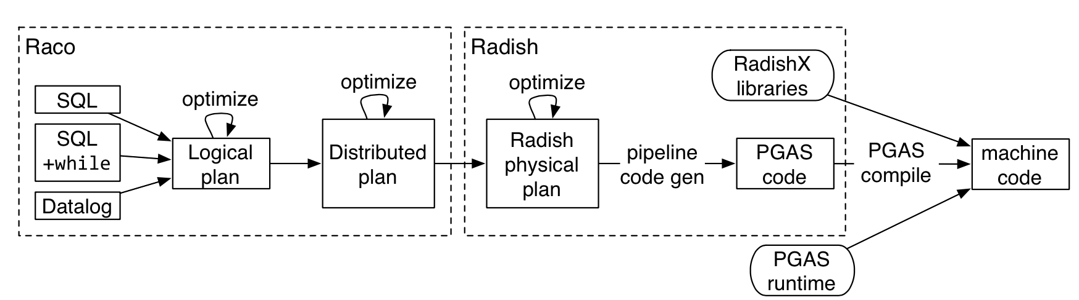
Hybrid Graph Analytics: Graph Patterns
RADISH [Myers 15]
Compile algebra to bare metal PGAS programs
Notes:
And that’s just usinga parallel database. If we instead generate parallel programs and compile them the way the HPC folks do, we can beat up on Spark/Shark basically due to aggregating messages and removing serialization overhead.

Slide 23
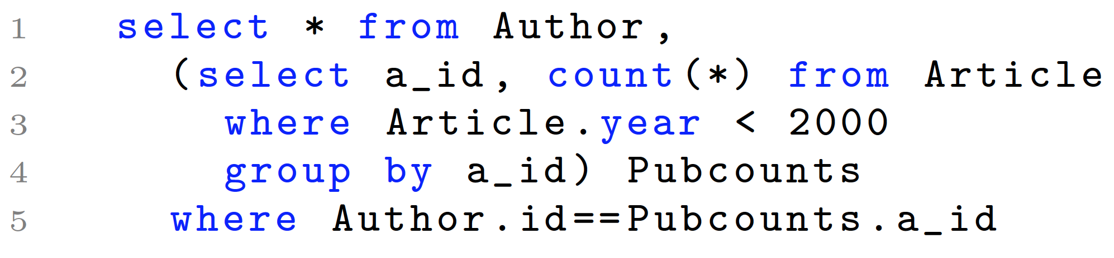

Slide 24
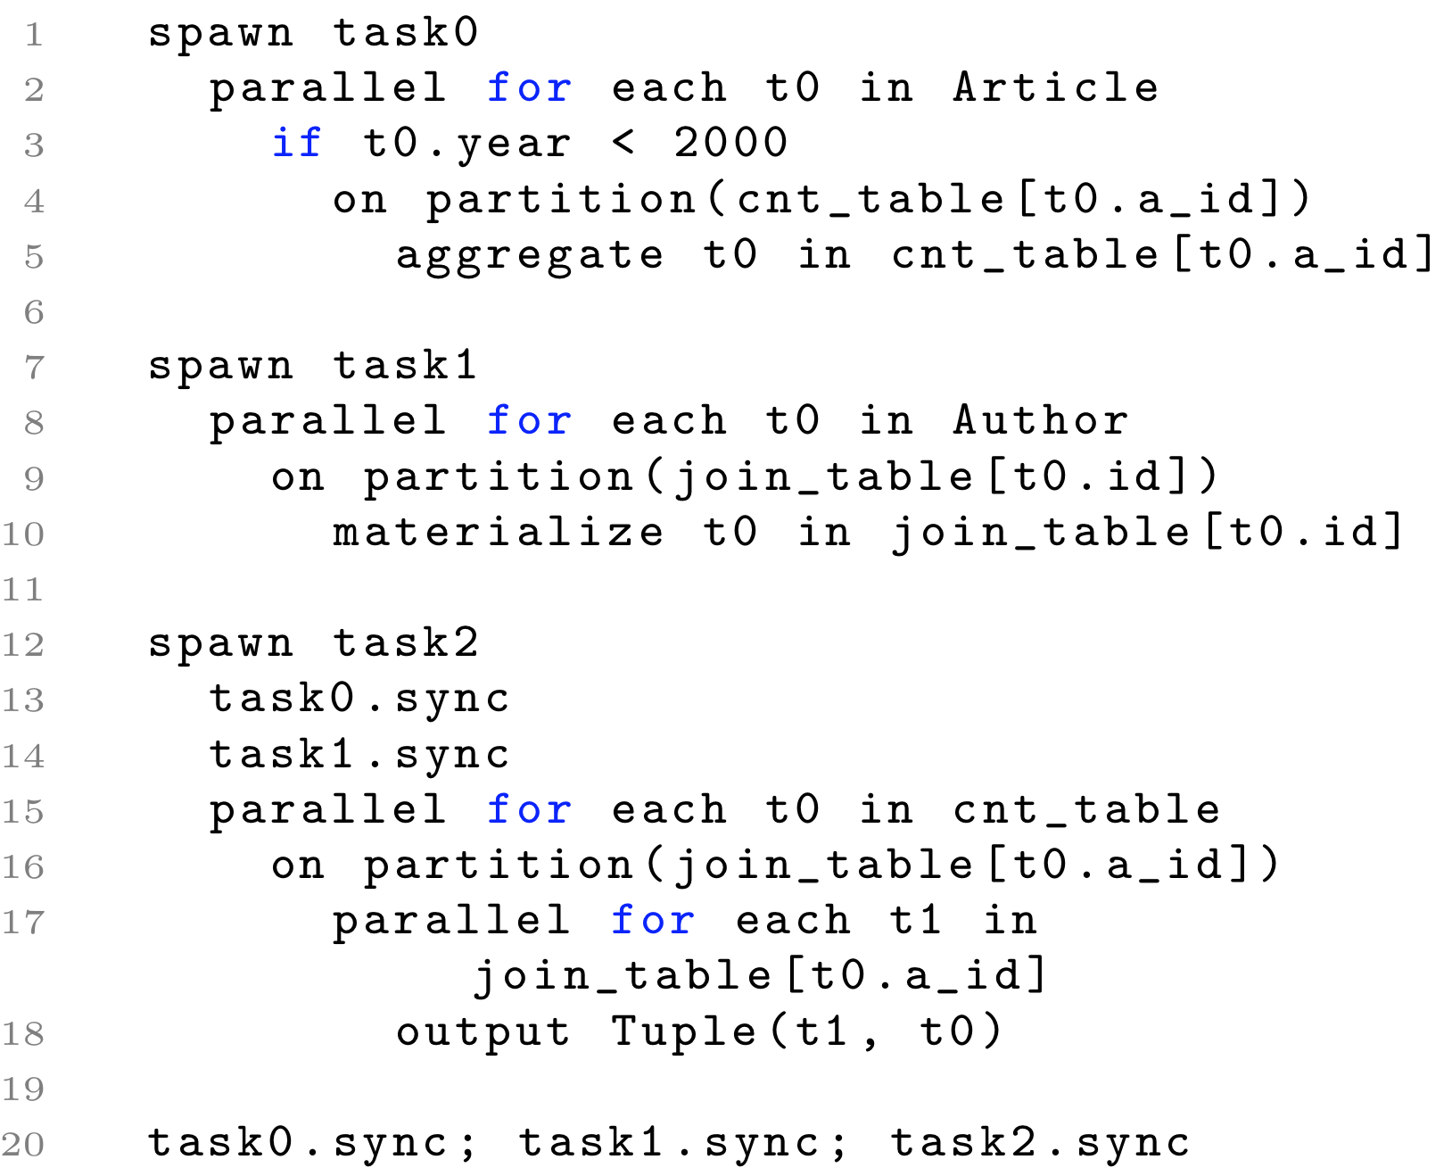

Slide 25
Compilation to PGAS
spawn task0 {
parallel for t in Article {
if t.year < 2000 {
on partition(hash(t.author_id)) {
atomic cnt_table[t.author_id] += 1
}
}
}
}
for t in Article {
if t.year < 2000 {
cnt_table[t.author_id]+=1
}
}
Notes:
looks like histogram code
mention:
between-pipeline with tasks
within-pipeline with atomics

Slide 26
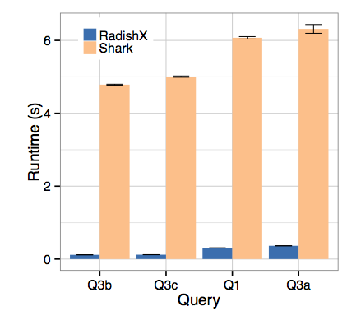
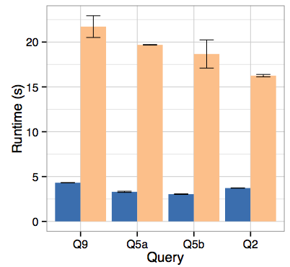
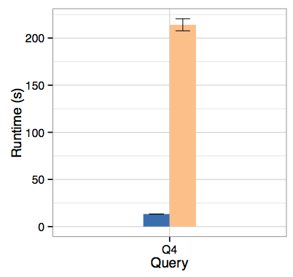
Graph Patterns
RADISH [Myers 15]
SP2Bench, 100 million triples
Queries expressed in MyriaL, an iterative relational language
Queries compiled to a PGAS C++ language layer, then compiled again by a low-level PGAS compiler
This is one of Myria’s supported back ends
Comparison with Shark/Spark, which itself has been shown to be 100X faster than Hadoop-based systems
…plus PageRank, Naïve Bayes, and more

Slide 27
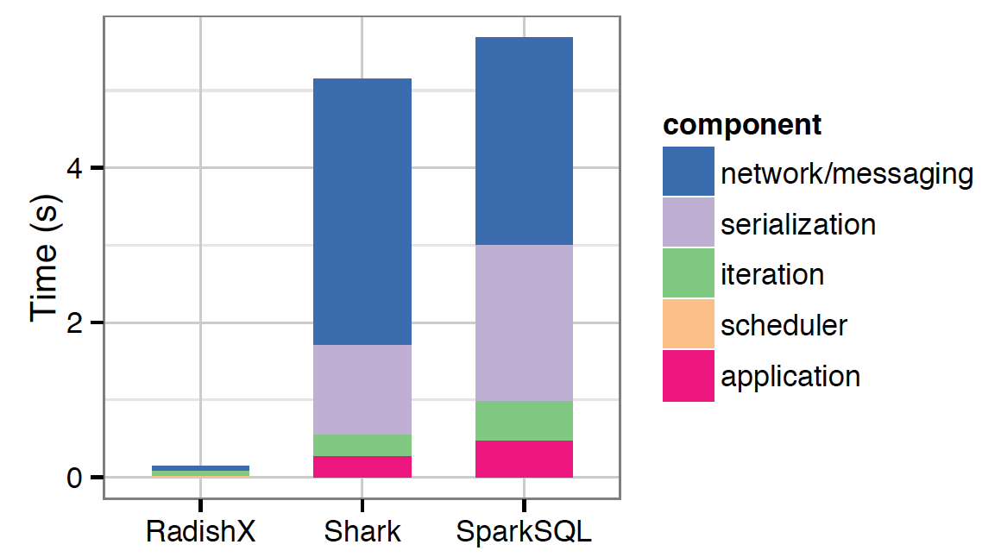
1% selection microbenchmark, 20GB
Avoid long code paths

Slide 28
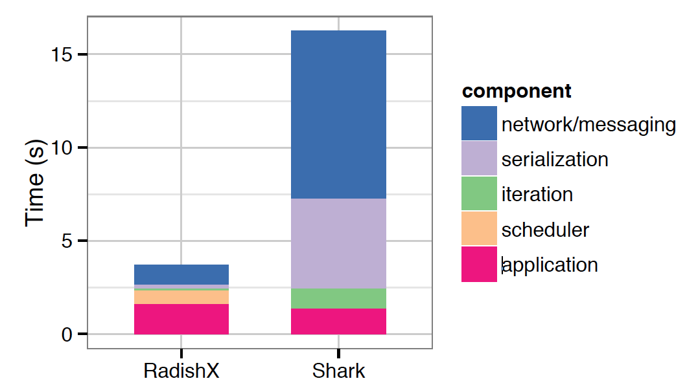
Q2 SP2Bench, 100M triples, multiple self-joins
Communication optimization

Slide 29
The performance gap
Hand-coded
Performance
Query
Productivity
Notes:
there has already been ~2 orders of magnitude improvement
for in-memory analytical queries

Slide 30
Key question: What is the price of abstraction?
What are the fundamental differences in expressiveness and performance between specialized graph systems, array systems,key-value systems, relational systems, and general-purpose data flow systems?
Can the performance of programs compiled from high-level abstractions compete with the performance of hand-coded programs for specialized tasks?
Can performance gaps between systems be mitigated by algebraic optimization at the level of a middleware?

